Slide 1
Announcements
ACC Starts Tuesday, January 19th
If you are retaking an ACC class, $150 and your Student Drop Form is due by Tuesday, January 19th
Junior PSAT January 26th from 8:40-12 PM
STUCO T-shirts are NOW AVAILABLE
Books are Available

Slide 2
Creating a Personal Statement
A personal statement or an essay, is the way to show your prospective university who you are.
Ask yourself:
What you are passionate about?
What are three accomplishments in your life you are proud of?
Is there someone in your life who inspires you?
The next slide contains the college essay prompts. Read over them and consider what you might write. Jot some notes down.

Slide 3
College Essay prompts
Essay A:
Tell us your story. What unique opportunities or challenges have you experienced throughout your high school career that have shaped who you are today?
Essay B:
Most students have an identity, an interest, or a talent that defines them in an essential way. Tell us about yourself.
Essay C:
You’ve got a ticket in your hand – Where will you go? What will you do? What will happen when you get there?

Slide 4

Building your
College Resume
If you have not yet done this:
This activity will take 5-10 mins.
Open up a Google Doc and name “College Resume”. (This will be a document you will adding to and editing for the next few years.)
Take some time to think about what you have achieved so far in your high school career.
On the next slide, we are going to write out these accomplishments. This information will help us fill out your college applications.

Slide 5
Building your
College Resume
Jobs- List all the jobs you’ve held, where you worked, for how long and what your title was. Ex. Cashier at HEB, 8 months
Activities- List all your extracurricular activities, both in and out of school, and how long you participated in them. Ex. Student Council for two years, National Honor Society for one year, Drama Club for three years, etc.
Experience/ Skills- List any experiences or skills you have gained form your jobs and activities. Ex. Leadership skills, speaking skills, online learning skills, how to plan an event and budget, etc.

Slide 6
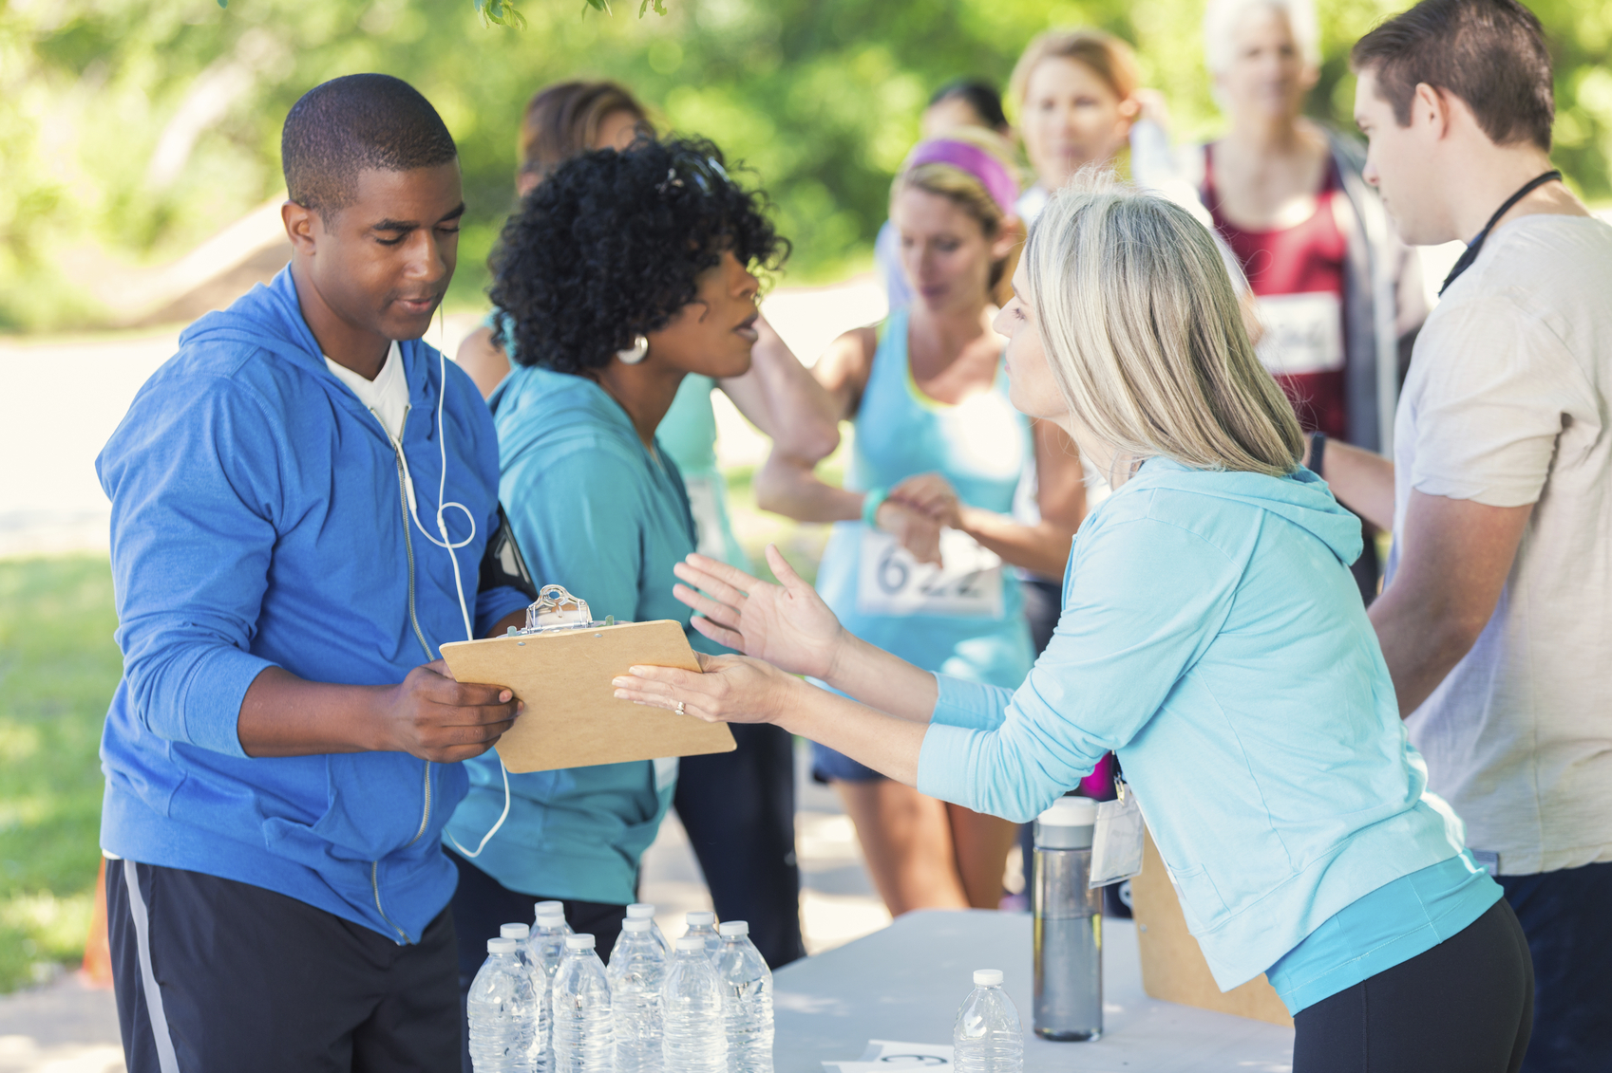

Building your
College Resume
Volunteer work/ community service- List all the volunteer work you have done, whether it was an ongoing commitment or a one-time thing.
Honors/ Awards- List any awards, honors, or recognition that you’ve received over the years- both in school and outside of school. Ex. Principal’s List for achieving a 3.2 GPA.

